Slide 1
NIFTY-50 STOCK MARKET (2000-2021)
Presented By : - Pratik Deore

Slide 2
Agenda
01
Stock Market Details & About Stock Data
02
Problem Statement 1
1.Which Industry Has the Most No. of Companies in NIFTY 50
03
Problem Statement 2
1. TATA STEEL Stock Market Open/Close Point
2. Adani Stock High/Close Trading Point
3. Wipro Stock Data 2019 Year
04
Problem Statement 3
1. Relation Between TCS,TATA Motor, TATA Steel Opening Price
2. 15 StockTrade High / Low Score

Slide 3
Stock Market Details
Open
Close
The opening price is the price from the first transaction of a business day. Sometimes these prices are different.
The close is a reference to the end of a trading session in the financial markets when the markets close for the day
High
Low
high is the highest price at which a stock traded during the course of the trading day
low is the lowest price that a stock trades in that day. It can be difficult to predict a stock's intraday low.
$300.50
BUY
SELL
$203.00

Slide 4
Now that our data has been converted into the desired format, let’s take a look at its various columns for further. analysis
The Open and Close columns indicate the opening and closing price of the stocks on a particular day.
The High and Low columns provide the highest and the lowest price for the stock on a particular day, respectively.
The Volume column tells us the total volume of stocks traded on a particular day.
The Turnover column refers to the total value of stocks traded during a specific period of time. The time period may be annually, quarterly, monthly or daily.
VWAP also called The volume-weighted average price (VWAP) is a technical analysis indicator used on intraday charts that resets at the start of every new trading session.
Deliverable Volume also called Deliverable quantity is the total number of shares that were marked for delivery on a certain date. You can easily find these stats on the websites of BSE and NSE.
About the Stock Data
BUY
SELL

Slide 5
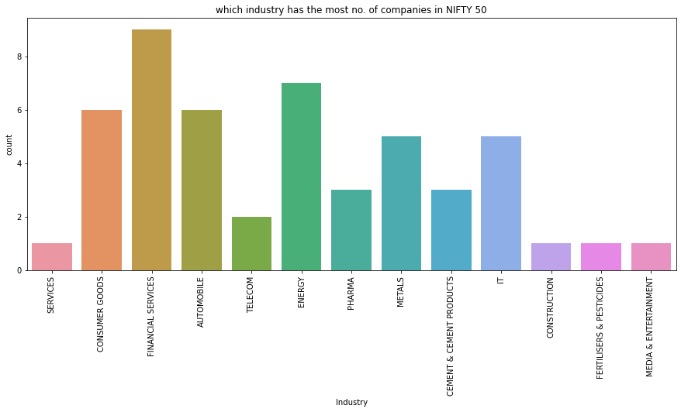

Which Industry Has the Most No. of Companies in NIFTY 50
Financial Service Industry has Most No. of Companies in Nifty 50
Services , Construction, Fertilisers & Pestisides , Media &Entertainment This Industry are Hold Less Companies in Nifty 50

Slide 6
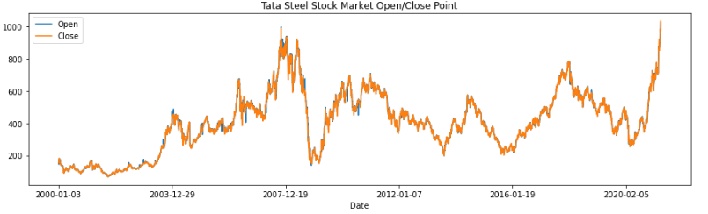
Tata Steel Stock Market Open/Close Point
01
Tata Steel is Open Highest Price will be 920 points and Close Price will be 980 points At 2020-02-05 on this date
02
In the Beginning of 2000-01-03 Tata Steel is Open will be 200 points & Close will be 210 points

Slide 7
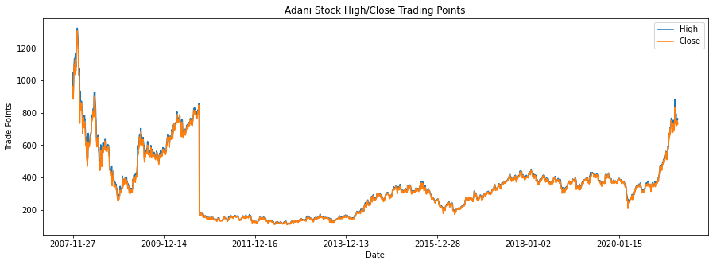
Adani Stock High/Close Trading Point
HIGH
CLOSE
In Adani Stock Highest Point would be 1300+ Points also That Time Close Point would be 1280 points in 2007-11-27
In Adani Stock Close lowest Point would be 200 Points also That Time High Point would be 210 points in 2011-12-16

Slide 8
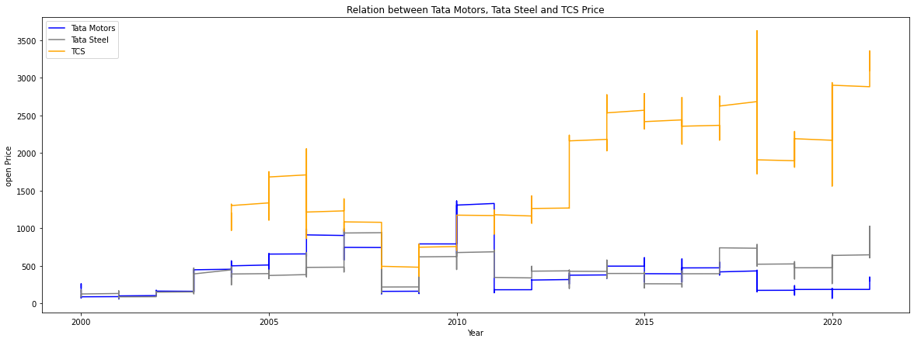
Relation Between TCS,TATA Motor, TATA Steel Opening Price
Here We Show 3 Relation Between TCS, Tata Motor, Tata Steel Opening Price Between 2000 Year to 2020 Year
So we See UP Points of TCS opening Price is Highest 3200 Points in 2018 Year , Tata Motor Opening Price is Highest 1500 points in 2010 Year , also Tata Steel opening Price is Highest 1000 Points in 2007 Year
UP
DOWN
Similarly So we See Down Points of TCS opening Price is Lowest 500 Points in 2008 Year , Tata Motor Opening Price is Lowest 200 points in 2020 Year during pandemic , also Tata Steel opening Price is Lowest 300 Points in 2000 Year

Slide 9
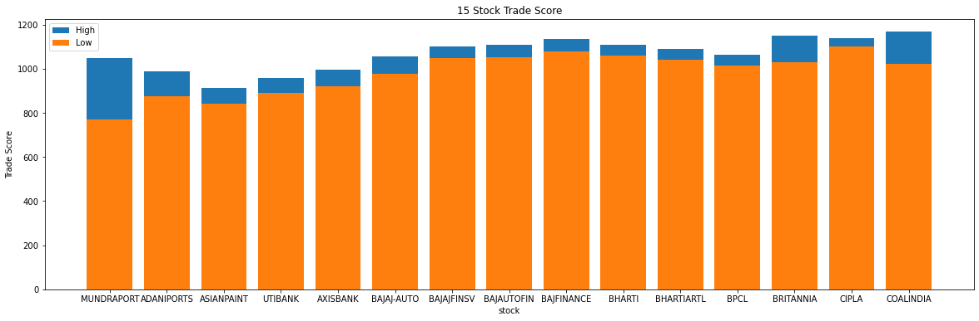
15 StockTrade High / Low Score
Here We See 15 Stock Trading High / Low Score Point
We see Britania & Coal India & Cipla was Highest Score More Than Other Rest of Stock Trade
Adani Mudra Port Stock , Asian Paints, UTI Bank & Axis Bank was Lowest Score than Other Rest of Stock Trade

Slide 10
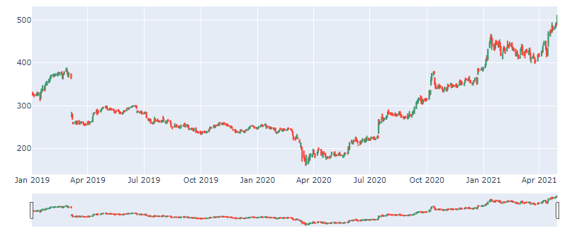
Wipro Stock Data For 2019 Year
We Take Wipro Stock Data for 2019 Year
In Apr 2021 Wipro was High in This Year almost touch 500 Points
In Apr 2020 Wipro was Bad in This Year 150 Points

Slide 11

Thank You

